Slide 1


ONLINE RETAIL REVENUE INSIGHTS
Shirley Nakalema
Notes:
Hello and welcome,
my name is Shirley and in this presentation, i will take you through the company‘s online retail revenue and sales performance for 2010 and 2011

Slide 2
AGENDA
Introduction
Data Processing
Exploratory Analysis
Recommendations
Notes:
First, i will give you a breaf introduction of the analysis,
then i will take you through the data processing
followed by the exploratory analysis
and lastly, some of the recomendations i have

Slide 3
INTRODUCTION
The purpose of this analysis is to show metrics that can evaluate business performance.
The analysis can help in giving insights in expansion and showing revenue information of the company.
Notes:
Lets start with an introdution. Where the
The purpose of this analysis is to show metrics that can evaluate business performance.
The analysis can help in giving insights in expansion and showing revenue information of the company.
next, am going to take you through the data processing

Slide 4
DATA PROCESSING
Processed data with Power BI
Neative values from the quantity column removed.
Unit prices below $0 removed.
Noticed descriptions with question marks which was removed.
Notes:
The data is processed with Power Bi by sorting and filtering the data to remove unwanted values that can interfere with the results of our analysis.
We removed values from the quantity column that shows negative values.
We also removed unit prices that are below $0.
We also noticed that there are product description that has question marks on it depicting the information as unknown for those products, so we removed after the filtering. Aside from these corrections, the data is accurate and relevant to answer the business tasks.
next, i will talk about the insights from this data

Slide 5
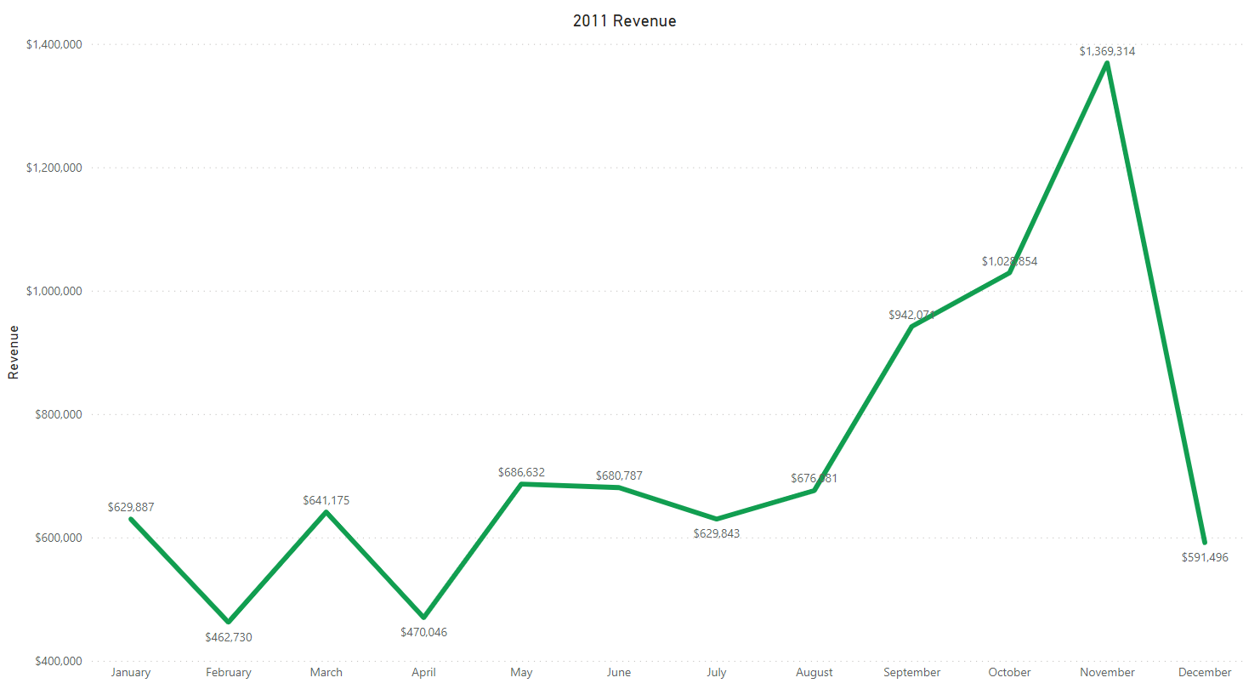
EXPLORATORY ANALYSIS
Notes:
Here we can see the trend of revenue through the year 2011.
August is when the revenue is going a positive direction through November.
November is the month with the most revenue generated by the company.
There is incomplete data about December to confirm seasonality of revenue.

Slide 6
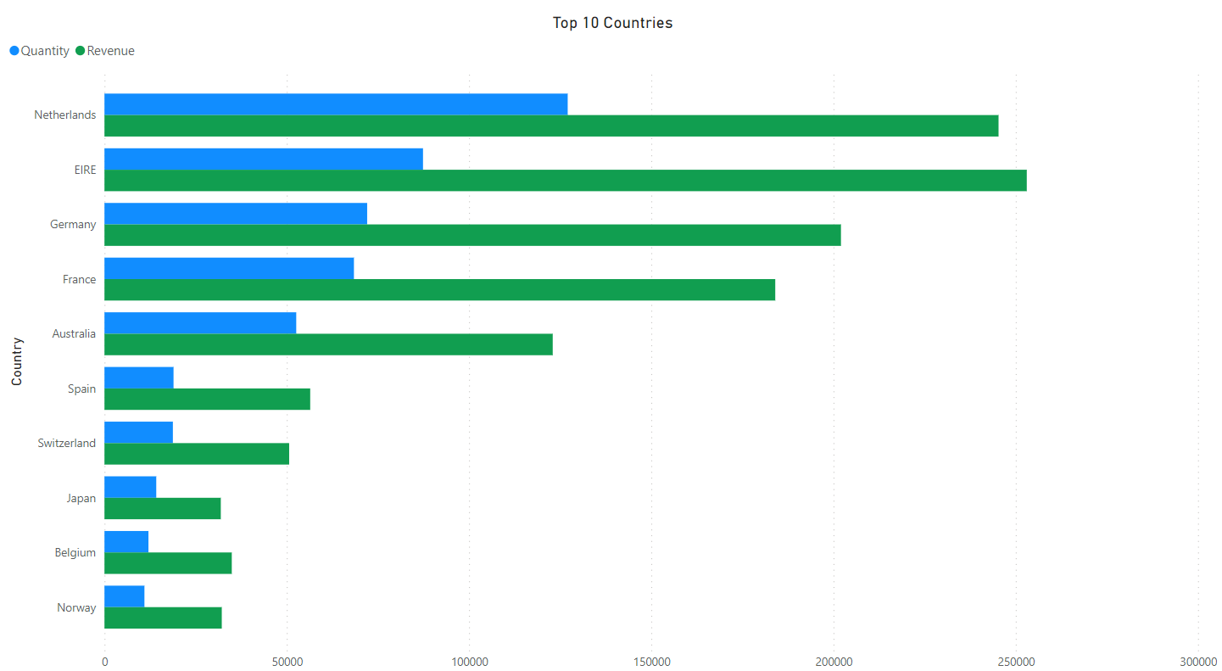
EXPLORATORY ANALYSIS
Notes:
Netherlands is the country that generated the most revenue out of 38 countries followed by Ireland and Germany.
We noticed that the quantity sold corresponds to the revenue recieved, the more items sold, the more revenue.
The products sold in Netherlands might be cheaper compared to the ones sold in Ireland.

Slide 7
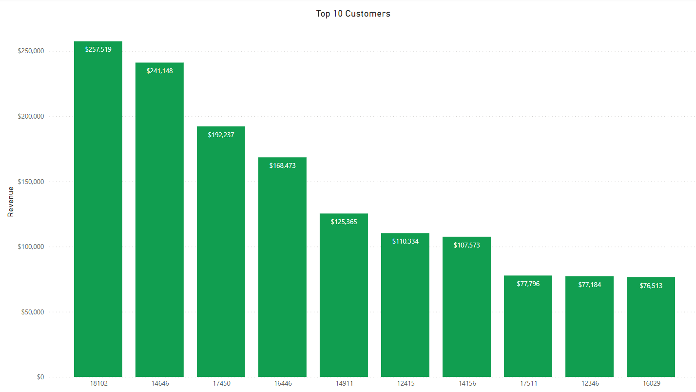
EXPLORATORY ANALYSIS
Notes:
Here we see the top 10 customers by revenue.
The top customer generated about $257,519.
There are 2 customers that generated an average of $77,000 and $56,000 in revenue which is the 9th and10 customerID 12346 and 16446 respectively.

Slide 8
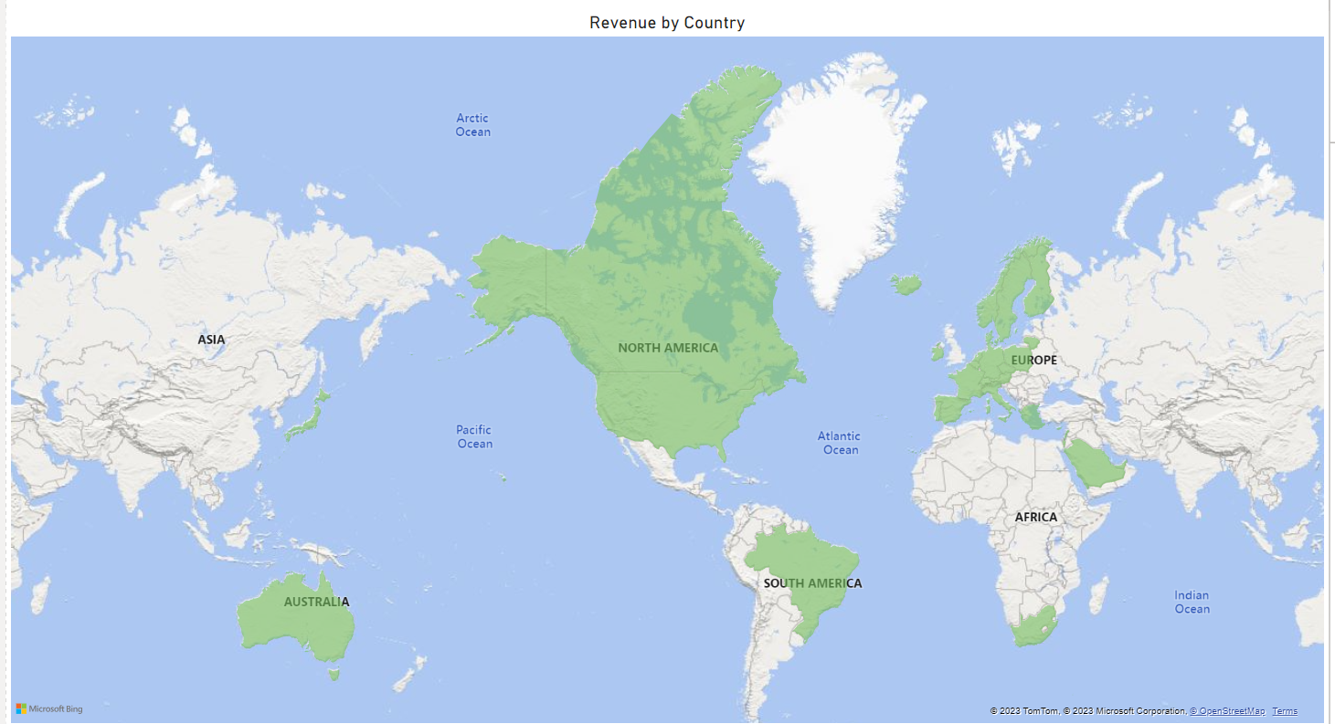
EXPLORATORY ANALYSIS
Notes:
North America has the highest revenue which makes it the best place for a business expansion.
The surrounding areas around Ireland seems promising for the popularity of the business.
Places like like Australia, South America and Europe have a significant customer base that can also be looked at for opportunities.
so, with that, i have some recomendations

Slide 9
RECOMMENDATIONS
Look into high demand products
Look into products generating highest revenue.
Top revenue customers can be offered deals as a reword.
Stock and advertise seasonal products.
Netherlands and the surrounding areas have great revenue and a significant customer base that we can use in marketing.
Data such as profit can be used in future analysis to evaluate more of the business performance
Notes:
The company should come up with strategies that aim at stocking and advertising seasonal products to maximize sales
The company should look into products generating highest revenue for each region in order to better market these products for more revenue.
The company should consider top revenue customers to strengthen the relationship with these customers by offering them some deals.
The company should come up with strategies that aim at stocking and advertising seasonal products to maximize sales when the demand for these goods goes up.
Netherlands and the surrounding areas has generated great revenue and the company has a significant customer base that we can tap into for expansion opportunities.
Data such as profit can be used in future analysis to evaluate more of the business performance

Slide 10
Thank You
Any Questions?

